Slide 1
Context
3WEBD

Slide 2
3WEBD – Optimization
Course Objectives
By the end of the course, students should:
Be aware of a context use case
Know how to implement a context
Be able to use Redux
Time:
course: 3h
exercises: 4h

Slide 3
Summary
Context use case
Context provider
Redux

Slide 4
1. Context use case

Slide 5
1. Context use case
As you know, state is only handled at a component level. If you want to send some data from one component to a child component you need to pass the value as a prop. And if you want to send a value to a second level child component, you need to pass and forward the value. This is quite exhausting and hard to maintain on large applications.
But it is even more complicated to “lift the state up” or simply send back information from a component to a parent component.

Slide 6
1. Context use case
In React, we use a lot of props, and depending on your components organization and infrastructure, you may have to send props from a main page to a sub component that is multiple layer deep.
That is an issue as you are write code to handle the props to only forward the prop to another component: this is called “Prop drilling”

Slide 7
1. Context use case
Prop drilling in React refers to the process of passing data from one component through several layers of nested components to reach a deeply nested component that needs the data.
This is done by passing the data as props through each layer of the component tree, even if intermediate components do not need or use the data themselves.

Slide 8
1. Context use case
While prop drilling is a straightforward concept and can be suitable for small applications or shallow component trees, it introduces several issues as applications grow in complexity
Maintainability: As the component tree becomes deeper, maintaining the flow of props can become cumbersome. Changes to the structure of your data or the component tree can require refactoring at multiple levels, increasing the risk of errors.

Slide 9
1. Context use case
Component Reusability: Intermediate components that are forced to pass down props they don't use become less reusable. To use these components in different contexts, you often need to provide the same props, even if they are irrelevant in the new context, leading to bloated component APIs.
Readability: Prop drilling can clutter component APIs with props that are only relevant to deeply nested components, making it harder to understand the role and usage of each component at a glance.

Slide 10
1. Context use case
Coupling: It creates a tight coupling between components in the hierarchy. Changes in the data structure or requirements of a deeply nested component can necessitate changes across all intermediate components, violating the principle of encapsulation.

Slide 11
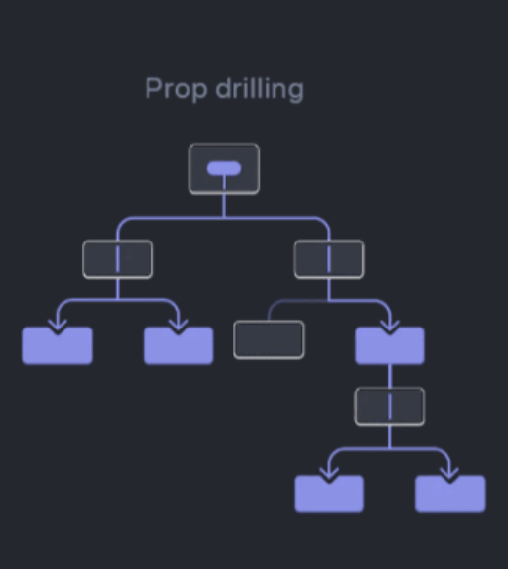
1. Context use case
Prop Drilling

Slide 12
1. Context use case
React provides several solutions to mitigate the issues caused by prop drilling and one can be better than another one depending on your project and use case
Composition: Using composition patterns, such as render props or children as functions, can help manage how components share data. These patterns provide more flexibility in how components receive data and can reduce the need for prop drilling.

Slide 13
1. Context use case
Context API: React's Context API allows you to share data globally across the component tree, making it accessible to any component in the tree without having to manually pass props down through each level.
This is ideal for data that needs to be accessed by many components at different nesting levels, such as themes, user authentication status, or language settings.

Slide 14
1. Context use case
State Management Libraries: External state management libraries like Redux or MobX offer solutions for managing application state outside the React component tree.
This can simplify data access across deeply nested components and eliminate the need for prop drilling.

Slide 15
1. Context use case
While prop drilling is a simple mechanism for sharing data in React, it can lead to issues in larger applications.
Leveraging React's Context API, adopting composition patterns, or using state management libraries can help avoid the drawbacks of prop drilling, leading to more maintainable, readable, and loosely coupled component structures.

Slide 16

Exercises

Slide 17
2. Context provider

Slide 18
2. Context provider
One of the preferred way to handle the issue of prop drilling or lifting the state up is to use the “new” Context principle. The Context API is a feature provided by React that enables you to exchange unique details and assists in solving prop-drilling from all levels of your application.

Slide 19
2. Context provider
It's designed for sharing data that can be considered "global" for a tree of React components, such as the current authenticated user, theme, or preferred language.
The Context API makes this data accessible to any component in the component tree without having to pass props down manually at every level.

Slide 20
2. Context provider
The Context API is particularly useful in scenarios where you need to pass data through many layers of components, such as:
Theme switching (dark mode/light mode settings)
Language preferences for internationalization
User authentication status and user preferences
Application-wide state management for certain data

Slide 21
2. Context provider
The Context API works by creating a Context object through React.createContext() and using this object's Provider and Consumer components to share data across the component tree.

Slide 22
2. Context provider
Creating Context: You start by creating a Context object with React.createContext(). This object includes a Provider and a Consumer (or useContext hook for functional components).

Slide 23
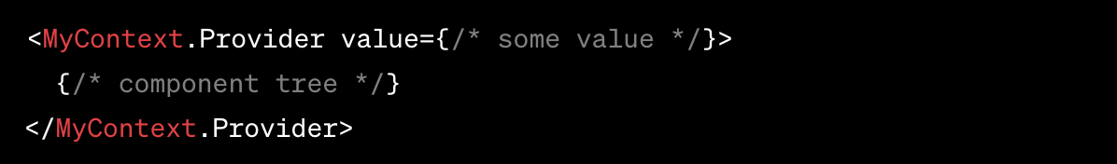
2. Context provider
Providing Context: The Provider component wraps a part of the component tree and provides the context to all components within that tree, regardless of how deep they are. The Provider component accepts a value prop to be passed to consuming components that are descendants of this Provider.

Slide 24
2. Context provider
Consuming Context: Components within the Provider's component tree can access the context value in several ways:
Using the useContext hook in functional components, which accepts the context object as an argument and returns the current context value.

Slide 25
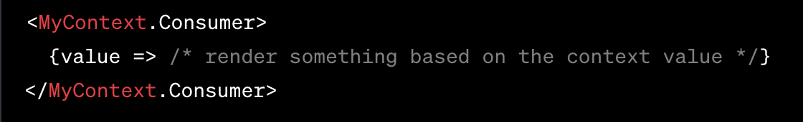
2. Context provider
Using the Consumer component in both functional and class components, which uses a render prop pattern to access the context value.

Slide 26
2. Context provider
While the Context API simplifies data sharing across components and solves prop-drilling issues, it's important to use it judiciously.
Overusing Context can make component reuse more challenging and lead to performance implications if not managed correctly, especially with frequent updates to context values that trigger re-renders of large parts of the component tree.

Slide 27
2. Context provider
Another important point is to note that the context is not always at the root level of the application. It is normally declared where you need it.
On specific instances you could have multiple context on different part of your application. This allow to separate your context and only share information where this is needed.

Slide 28
Exercises

Slide 29
3. Redux

Slide 30
3. Redux

Slide 31
3. Redux
Redux is a predictable state container for JavaScript applications, most commonly used with libraries like React to manage application state in a centralized, predictable way.
It helps applications to behave consistently across different environments, making state management easier and more transparent. Redux is based on three fundamental principles

Slide 32
3. Redux
Single Source of Truth
The state of the entire application is stored in an object tree within a single store. This makes it easier to keep track of state changes over time, debug or inspect an application, and persist the application's state.

Slide 33
3. Redux
State is Read-Only
The only way to change the state is to emit an action, an object describing what happened. This ensures that neither the views nor the network callbacks will ever write directly to the state. Instead, they express an intent to transform the state.

Slide 34
3. Redux
Changes are Made with Pure Functions
To specify how the state tree is transformed by actions, you write pure reducers. Reducers are pure functions that take the previous state and an action, and return the next state. It's important that reducers stay pure, without mutating the previous state, generating side-effects, or making asynchronous calls.

Slide 35
3. Redux
Redux offers several benefits in managing application state:
Predictability: With Redux, it becomes easier to predict application behavior, as the same state and actions will always produce the same result.
Maintainability: By centralizing the application's state and logic, Redux makes it easier to maintain and scale the application.

Slide 36
3. Redux
Developer Tools: Redux has strong support for developer tools, such as the Redux DevTools, allowing you to inspect and replay actions, track state changes over time, and more, which is invaluable for debugging.
Community and Ecosystem: Redux enjoys widespread adoption and has a vibrant ecosystem, with many middlewares and add-ons that extend its capabilities, such as handling asynchronous actions or integrating with different backend services.

Slide 37
3. Redux
Ease of Testing: The predictable nature of Redux, combined with its use of pure functions, makes it straightforward to test the application's logic.

Slide 38
3. Redux
A Redux application's architecture revolves around a strict unidirectional data flow composed of multiple steps
Dispatch Action: Actions are dispatched in response to user interactions or events, describing what happened.
Reducers Process Actions: Reducers determine how the state should change in response to actions. They are pure functions that take the current state and an action, and return a new state.

Slide 39
3. Redux
3. Store Updates: The Redux store updates the state based on the return value of the reducer.
4. UI Updates: The application's UI updates to reflect the new state.

Slide 40
3. Redux
Redux is particularly useful for large or complex applications with high interaction rates, where managing state directly within components becomes impractical.
However, for simple applications, using Redux might introduce unnecessary complexity.

Slide 41

3. Redux
Understanding Redux in on GIF

Slide 42
3. Redux
To not paraphrase the Redux tutorial, you can find all information on how you can install the package and the full tooling on the official website and tutorial section here
You can (and should) take a look at the core concept

Slide 43
3. Redux
Redux was one of the first State Management in React, that lead to new state management solution. Another well know tool is MobX
Three-Four years ago, almost all React projects started with Redux almost as a default setting. Since the introduction of the Context API (Provider and Consumer) the ecosystem changed to use a lighter solution and use use Redux as default - yet you will still find a lot of projects using Redux.

Slide 44
3. Redux
It is also important to note that today, Redux use and rely on the Context API whereas a few years ago it was not the case. Before the Context API, Redux handled the full setup for all the part of the state management.

Slide 45
Exercises

